Slide 1


Green Pace
Security Policy Presentation
Developer: Karen Bevis
Office : 1-555-444-1212 ext. 5454
Cell: 850-XXX-XXXX
Presentation Date: 8/14/2021

Slide 2

https://www.yubico.com/wp-content/uploads/2021/05/castle-1024x707.png
Yubico, 2021 via link: https://www.yubico.com/wp-content/uploads/2021/05/castle-1024x707.png

Slide 3

DEFENSE IN DEPTH OVERVIEW

Slide 4
THREATS MATRIX
Likely STD-003-CPP STD-004-CPP STD-005-CPP STD-009-CPP STD-010-CPP | Priority STD-003-CPP STD-004-CPP STD-005-CPP STD-009-CPP STD-010-CPP
Low priority STD-001-CPP STD-002-CPP STD-006-CPP STD-007-CPP STD-008-CPP | Unlikely STD-001-CPP STD-002-CPP STD-006-CPP STD-007-CPP STD-008-CPP

Slide 5
10 PRINCIPLES
1. Validate Input Data
2. Heed Compiler Warnings
3. Architect and Design for Security Policies
4. Keep it Simple
5. Default Deny
6. Adhere to the Principle of Least Privilege
7. Sanitize Data Sent to Other Systems
8. Practice Defense in Depth
9. Use Effective Quality Assurance Techniques
10. Adopt a Secure Coding Standard

Slide 6
CODING STANDARDS
There are many coding standards. Other than the top 10 basic principles, here at Green Pace, we comply with important coding standards as well. Here are our top ten coding vulnerabilities standards that we comply with:
1. Do not declare or define a reserved identifier
2. Do not cast to an out of range enumeration value
3. Guarantee that storage for strings has sufficient space for character data and the null
terminator
4. Do not use deprecated or obsolescent functions
5. Free dynamically allocated memory when no longer needed
6. Use a static assertion to test the value of a constant expression
7. Do not leak resources when handling exceptions
8. CPP. Close files when they are no longer needed
9. Use valid iterator ranges
10. Ensure that operations on signed integers do not result in overflow

Slide 7
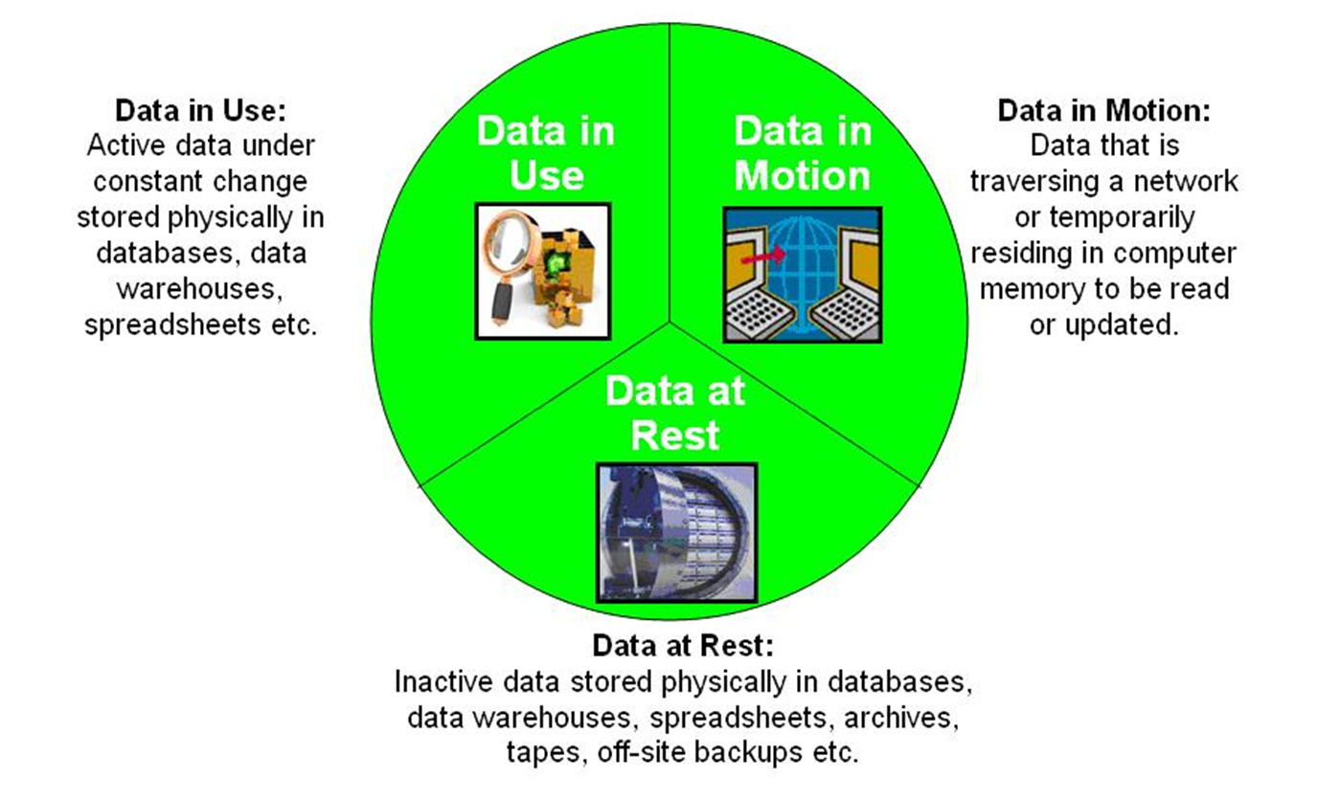
ENCRYPTION POLICIES
Image by: InfoSec, 2013

Slide 8
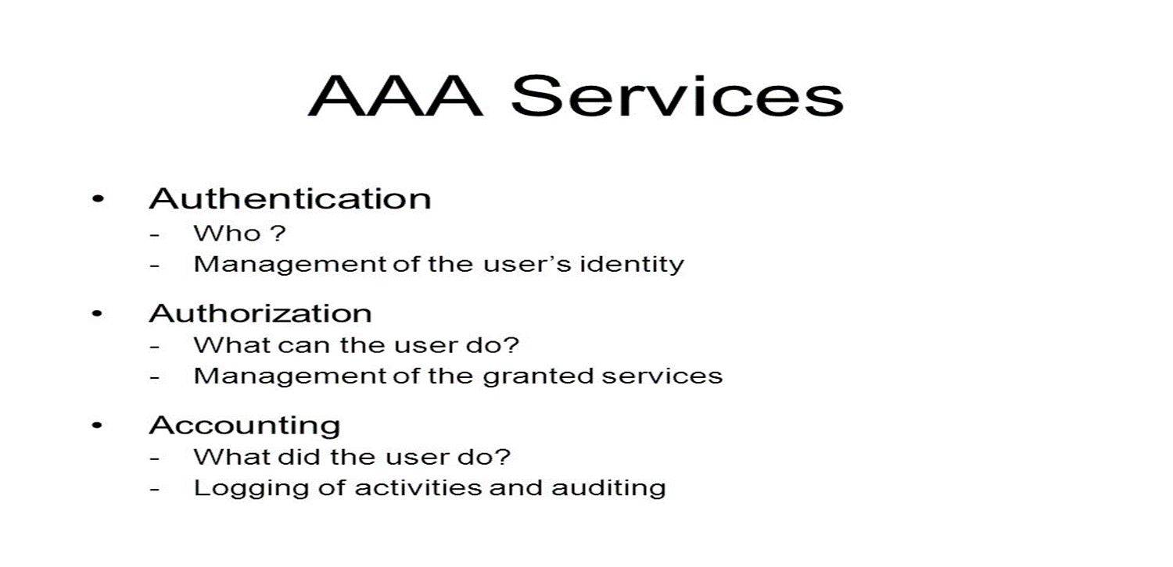
TRIPLE-A POLICIES

Slide 9
Unit Testing
// TODO: Create a test to verify reserve increases the capacity but not the size of the collection
TEST_F(CollectionTest, CapacityTest)
{
collection->clear();
ASSERT_TRUE(collection->empty());
//Set the size to collection to 4
collection->resize(4);
//Reserve the 5 more spaces in the collection
collection->reserve(9);
EXPECT_EQ(collection->size(), 4);
EXPECT_EQ(collection->capacity(), 9);
}

Slide 10
Unit Testing
// /TODO: Create a test to verify the std::out_of_range exception is thrown when calling at() with an index out of bounds
// NOTE: This is a negative test
TEST_F(CollectionTest, OutofBounds)
{
ASSERT_THROW(collection->at(100), std::out_of_range);
}

Slide 11
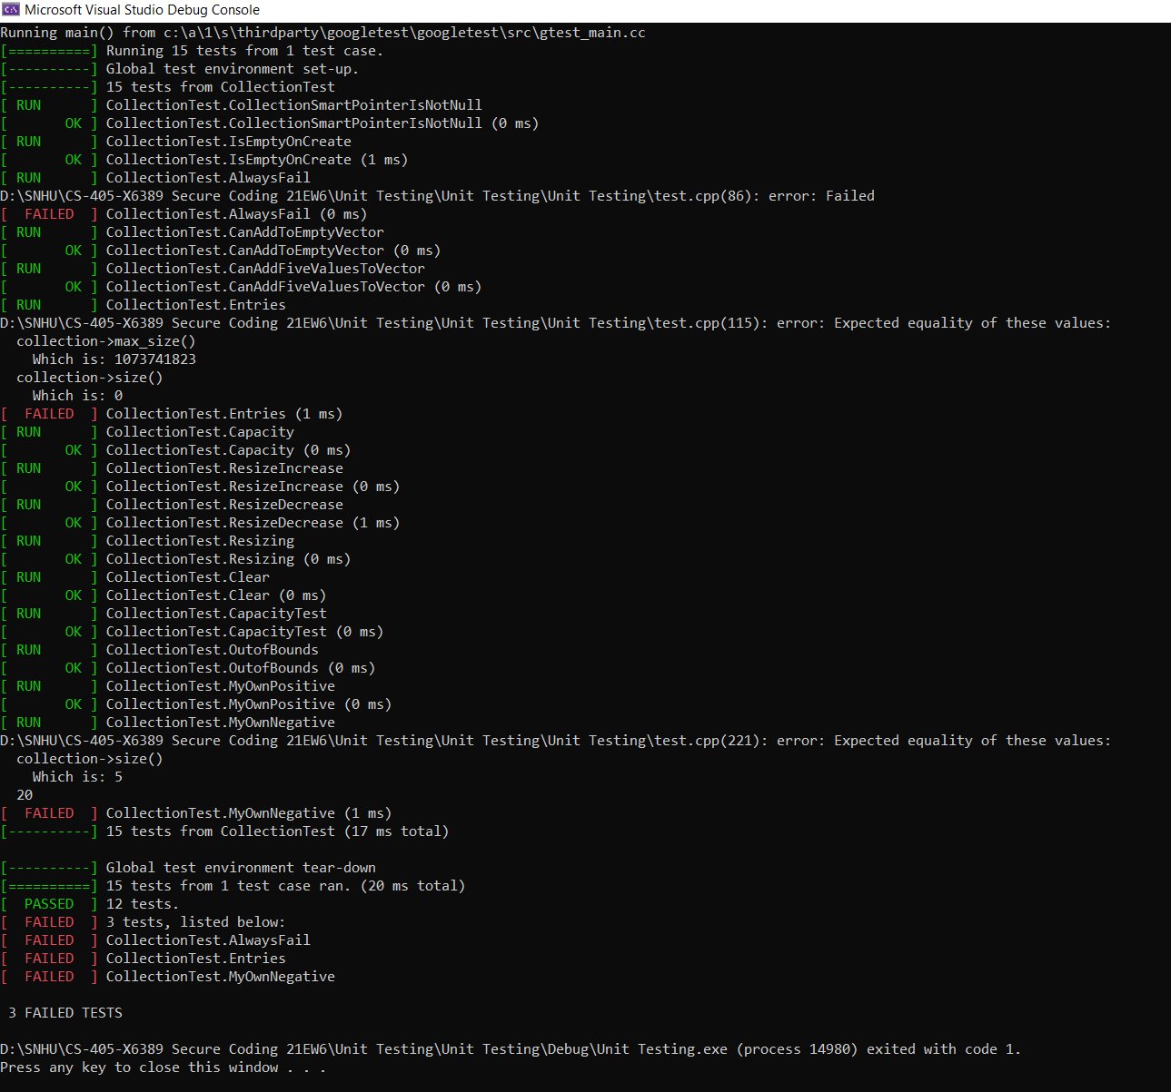

Slide 12

AUTOMATION SUMMARY

Slide 13
TOOLS
Threat Modeling
Security Tool Training
Static Application Testing
Automated Security Scans
Network Monitoring
Penetration Testing
Performance logs

Slide 14

RISKS AND BENEFITS
Improper access controls
Weak credential management
Cryptographic and privilege issues
Security misconfiguration
Image by: ClipArtBest.com

Slide 15

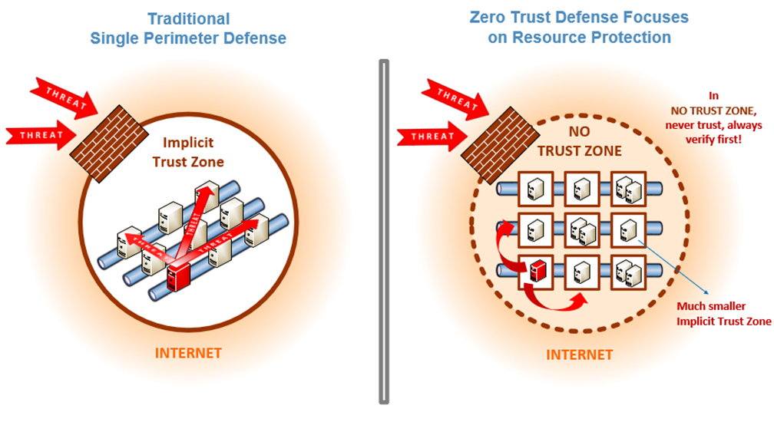
RECOMMENDATIONS
Photo by A.Kerman/Nist
Photo by: JuSun/iStock

Slide 16

CONCLUSIONS
Image by: Wallpapercave.com

Slide 17
REFERENCES
Seacord, R. (2020, November 18). Confluence. Retrieved from SEI
External Wiki Home: https://wiki.sei.cmu.edu/confluence/

